Slide 1

Information Science
GSCI1801A
Lecture 5: Data Communication and Computer Networks
Asst. Prof. Chawanat Nakasan | 2021-11-02
Enhanced Edition: 2021-11-05

Slide 2
Enhanced Edition
This slide file has been modified from its original version for better clarity.
Slide numbers may change, but none of the original content was removed.
It is safe for current students to use this file for study and examination reference.
Most of this information is presented from a “for users” perspective. This is because the goal of this class is for you to have appreciation for information science (know what we study and hopefully like it enough to learn more), not to become the next John von Neumann or Ada Lovelace.

Slide 3
Class Announcement
Report 1 is due next week.
レポート１の締め切りは来週です。
Submission closes 2021-11-09 11:59:59 JST.
Late submissions lose 20% points per day.

Slide 4
Agenda
Data Communication
Network Concepts
Exploring the TCP/IP Protocol Model

Slide 5
⚠️ Please save the slides! ⚠️
Content presented here is more detailed than the 情報の科学 official textbook.
Slides can be downloaded from the LMS.
Content from the slide may be on exam.

Slide 6
Data Communication

Slide 7
“the act or process of using words, sounds, signs, or behaviors to express or exchange information or to express your ideas, thoughts, feelings, etc., to someone else” – Merriam-Webster
“If you communicate with someone, you share or exchange information with them, for example by speaking, writing, or using equipment. You can also say that two people communicate.” – Collins Dictionary
share or exchange information, or express ideas
with someone else
by speaking, writing, moving your body, using equipment, or signals
“to share information with others by speaking, writing, moving your body, or using other signals” – Cambridge Dictionary
“the activity or process of expressing ideas and feelings or of giving people information” – Oxford Learner’s Dictionary

Slide 8

Communication Model (Modified and Interpreted for Data Communication)
Signal = Signaling method, etc.
Channel = Usually physical media + bandwidth, etc.
M
S
S’
M’
S
E
C
D
R
Message
Signal
Received Signal
Received Message
Sender
Encoder
(modulator)
Decoder
(demodulator)
Recipient
Noise
Message =
Content
Structure
Code
Noise Source
This model is based on Shannon Model and Berlo’s SMCR Model.

Slide 9
Network Concepts

Slide 10
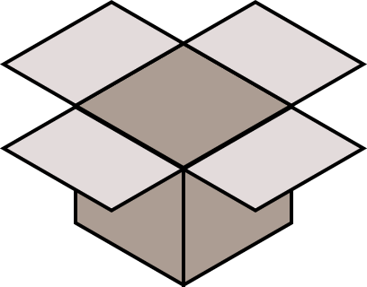

The Post/Mail/Courier Model Human Communication, Data Communication, sending things, all the same. (Use whichever word you remember.)
Load
Get
🚚
Pack
Send
Receive
Unpack

Slide 11
The Packet Model: Handling Large Data Sizes
Split data
1
2
3
4
5
6
Pack and encapsulate
🚚
🚚
🚚
🚚
🚚
🚚
Transmission

Slide 12
The Packet Model: Handling Different Data Formats
There are many kinds of data.
A packet containing data.
All packets look and behave the same.

Slide 13
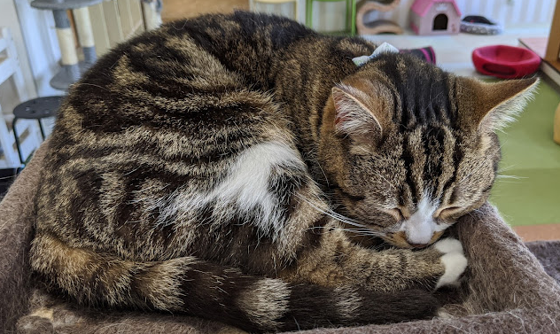

Abstraction
You can sleep easy!
It’s his problem now.
Once the item leaves your hands, you can rest assured it will arrive. The delivery is someone else’s problem.
You can assume that the delivery will somehow complete.
Death Stranding / Kojima Productions, via Gosunoob
Cat Photo: Own Work, Cat is a staff member at Mikan Neko Cat Cafe, Kurashiki

Slide 14
The Network Stack
Therefore, the network is all about processes:
Receiving input
Passing it along
Processing it for transmission
Processing it for reception
Passing it along
Receiving input
(Sending side)
(Receiving side)

Slide 15
The Network Stack
Horizontal compatibility:
Protocols work with same protocols across the network
Since communication creates multiple levels of information processing, this results in a “stack” of many layers.
Layer 5
L5-Protocol
Layer 5
Layer 4
L4-Protocol
Layer 4
Layer 3
L3-Protocol
Layer 3
Vertical compatibility:
Protocols work with other protocols in nearby layers of the same machine.
Layer 2
L2-Protocol
Layer 2
Layer 1
L1-Protocol
Layer 1

Slide 16
Open Systems Interconnection (OSI) Model
OSI-L7
Application Layer
This concept of a network stack is formalized into a global standard.
The ISO (International Organization for Standardization) defines the OSI Model (Open Systems Interconnection Model) as a 7-layer system of computer network elements.
OSI-L6
Presentation Layer
OSI-L5
Session Layer
OSI-L4
Transport Layer
OSI-L3
Network Layer
OSI-L2
Data Link Layer
OSI-L1
Physical Layer

Slide 17
Open Systems Interconnection (OSI) Model
OSI-L7
Application Layer
Provides functional utility to the user or system operations, such as web content (HTTP), email (SMTP), and network configuration (DHCP).
OSI-L6
Presentation Layer
Data encoding and translation, such as data type definition (MIME types), character systems (ASCII), etc.
OSI-L5
Session Layer
Provides session creation and maintenance (“logging in”) and manages long-term connections e.g. SOCKS and PAP.
OSI-L4
Transport Layer
Provides abstraction of applications into port numbers (multiplexing) and provides consistency (packet in-order) and speed (congestion) control.
OSI-L3
Network Layer
Provides addressing and routing between networks (across the Internet) on an individual packet basis.
OSI-L2
Data Link Layer
Provides communication within same network.
Provides abstraction of physical layer properties.
OSI-L1
Physical Layer
Defines how data is physically sent across the network, such as by wire and radio signals.
Don’t worry for now. Just keep this for your reference.

Slide 18
The TCP/IP Protocol Model
The TCP/IP Protocol Suite reduces some layers from the OSI model and changes some definitions.
It is considered more practical for general, research, and educational use.
There are many forms of TCP/IP Protocol Models, but in this class, we will use this model.
Kanazawa University official textbook uses a 4-layer model.
Application Layer
Transport Layer
Network Layer
Data Link Layer
Physical Layer

Slide 19
Comparison between OSI and TCP/IP Protocol Model
OSI-L7
Application Layer
Application Layer
OSI-L6
Presentation Layer
OSI-L5
Session Layer
OSI-L4
Transport Layer
Transport Layer
OSI-L3
Network Layer
Network Layer
OSI-L2
Data Link Layer
Data Link Layer
OSI-L1
Physical Layer
Physical Layer
OSI Model
TCP/IP Protocol Model

Slide 20
Addressing
Postal addressing
Locally (in-campus) addressed envelope
920-1192
Addressing allows the network elements to send to the correct destination.
It’s very similar to writing an address.
Different protocols use different kinds of addresses.
Part of the envelope analogy also lets us explore the concepts of encapsulation!
石川県金沢市角間町
金沢大学 学術メディア創成センター
角間 あざみ 様
EMI 角間あざみ 様

Slide 21
Encapsulation
Message
Application
App-Header
Message
Transport
Transp.-Header
App-Header
Message
Network
Net-Header
Transp.-Header
App-Header
Message
Data Link
Link-Header
Net-Header
Transp.-Header
App-Header
Message
Physical

Slide 22
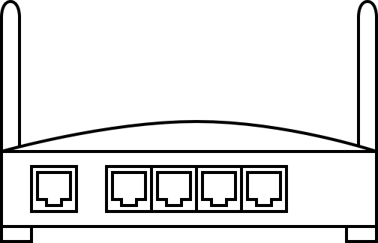
Signal Modulation
(Data sequence)
= [01]*
Link-Header
Net-Header
Transp.-Header
App-Header
Message
“MODEM”
Modulation
Demodulation
(Signal)

Slide 23
Hey, we’re at the bottom of the stack!
Application Layer
Wired (有線)
Transport Layer
Wireless (無線)
Network Layer
Data Link Layer
Physical Layer
TCP/IP Protocol Model

Slide 24
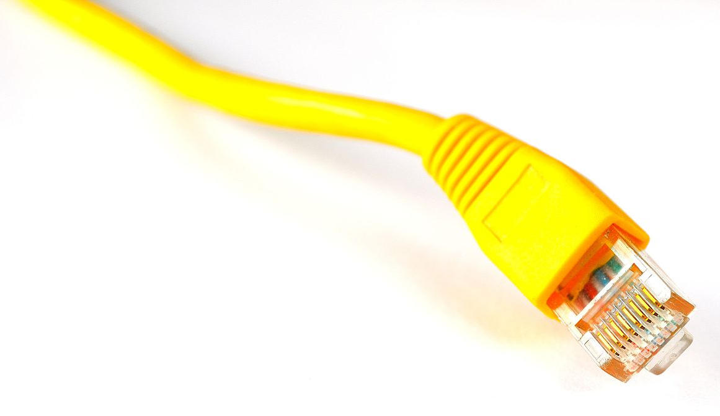
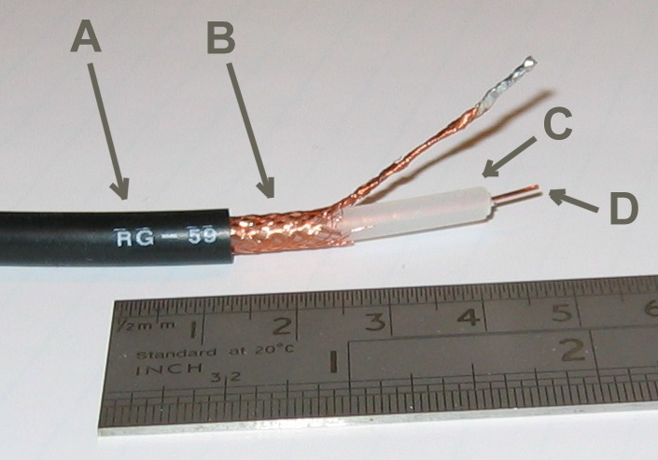
Types of Wired Media
Twisted-Pair Cables (“LAN Cables”)
Copper Cables
Wired
Optical Cables (“Hikari”)
Coaxial Cables
(“Subscriber TV / CATV Cables”)
Wireless
Image Sources:
Twisted-Pair Cable: Raysonho @ Open Grid Scheduler / Grid Engine
Coaxial Cable: Arj / Wikipedia

Slide 25
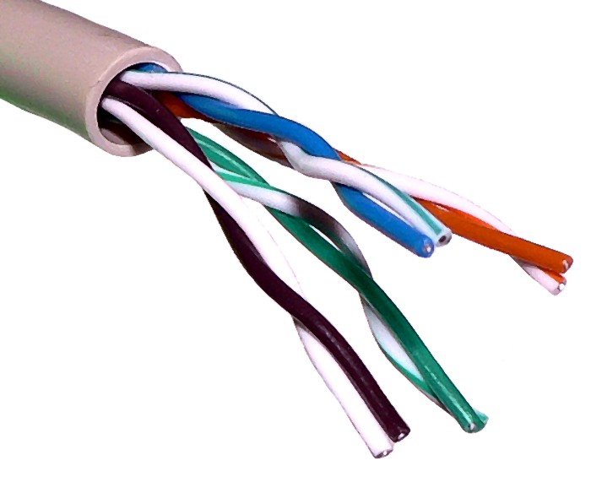
Twisted Pair Cables
Image Source: Baran Ivo / Wikipedia

Slide 26
How to choose cables?
Formally called Ethernet Cables, there are two popular ways to indicate a cable.
“Cat” System
(Common “market” language)
Cat 5e = Supports Gigabit Ethernet
Cat 6 = Supports 10Gig Ethernet
etc.
“Specification” System
Max Data Rate
10
100
1000
10G
“Baseband”
BASE
“Cable Class”
2 = up to 200 m
5 = up to 500 m
T = Twisted Pair
X = only 2 pairs used
F = Fiber Optic
Example: 1000BASE-T = 1 Gigabit Twisted-Pair Cable
Pros:
Easy to understand by consumers
Higher number is always more modern
Cons:
Does not reflect actual specification of the cable
Pros:
Very specific and you’re likely to get what you want if you order by this specification system.
Cons:
Most consumers don’t understand this system.

Slide 27
What about non-BASE things?
If it isn’t BASE(band), then it’s BROAD(band).
Broadband means multiple ranges of transmission frequency is mixed into the cable. Examples include “broadband internet” that uses multiple data channels.
If you have heard of the term “DOCSIS”, this is the formal term for what most of us use for broadband internet.
Broadband cables for ethernet is rare. There is a cable called 10BROAD36 (10 Mbps broadband over 3600 meters), but nobody really uses it.
You don’t have to worry about broadband cables. It will not be in the exam. (You will seriously learn about this if you go to a telecom company. They will pay you to learn about it.)
Baseband communication has only one base frequency.
There is no sense of “channels” here.
Broadband communication has many “channels”.
The “modem” at each side will merge/split these channels.
Typical cases of broadband communications include:
Digital Subscriber Line (DSL): Phone Voice + Internet
Cable Television (CATV): Television + Internet
※ This is an enhanced edition slide not included during live presentation.

Slide 28
Going Over 100m?
Most ethernet cables nowadays no longer support over 100m lengths. Here are some suggested solutions:
Using repeaters or chain with switches.
Using fiber optic systems. High upfront cost, but very high performance and can cover great distances.
Using wireless solutions is great when laying wires is expensive or impossible (two office buildings on two sides of public road, etc.)
※ This is an enhanced edition slide not included during live presentation.

Slide 29
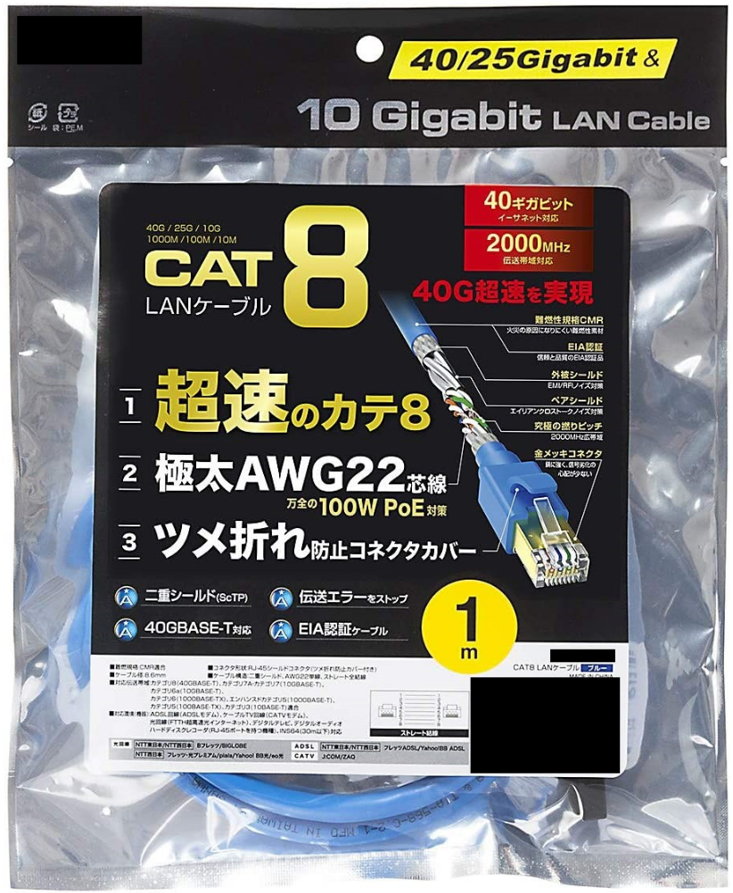
Example of properly labeled commercial (home-use) cables
“Cat” number
Cable thickness and power-over-ethernet support (good for CCTVs and IoT)
40GBASE-T =
up to 40 Gbps
baseband
twisted pair
Cable length
Clear technical specs and compatibility list
Straight or crossover cable. Some old devices require crossover, like switch-to-switch or PC-to-PC connections.
This is not a major concern nowadays.
Source: Commercial product being reviewed and critiqued.
※ This is an enhanced edition slide not included during live presentation.

Slide 30
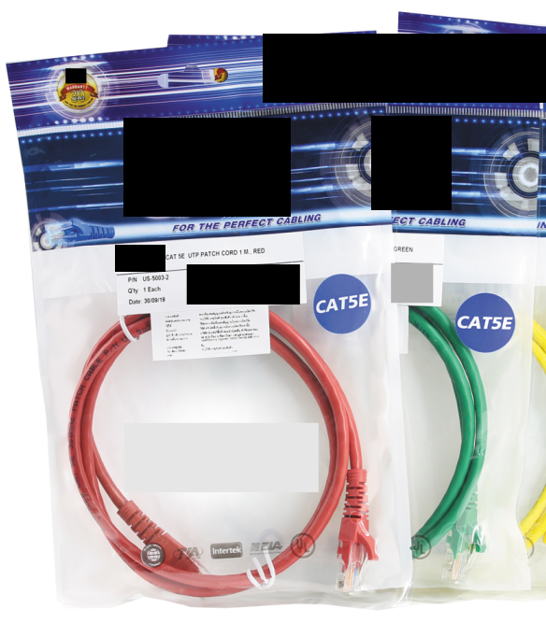
Example of dubiously labeled product (not as good, but enough information)
Cable length
“Cat” number
We can infer that this “Cat5e” (based on our knowledge) is a 1000Base-T cable. At least we know what we’re buying here.
Source: Commercial product being reviewed and critiqued.
※ This is an enhanced edition slide not included during live presentation.

Slide 31
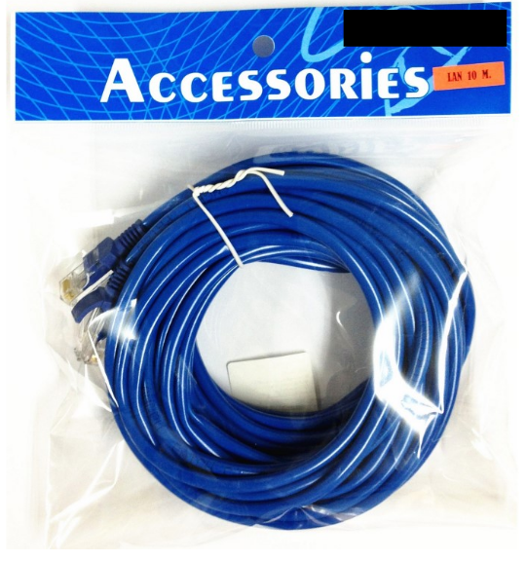
Example of poorly labeled product
No product name
(“LAN” is not adequate as a product name)
Only length is indicated
No category or other specification
There might be something on the back, but it’s probably just company address and barcode.
Anyway, we can’t see it here, so I’m not going to buy this brand online.
Do you trust this manufacturer?
Source: Commercial product being reviewed and critiqued.
※ This is an enhanced edition slide not included during live presentation.

Slide 32
Wireless Communication
Wi-Fi
Local Network
Bluetooth
Wired
Mobile Network
3G
4G
Wireless
Satellite
5G
Terrestrial
Microwave
Other Radio Techniques (SSB, etc.)

Slide 33
Wi-Fi
Standard | Max Data Rate | Frequency Band | Going through walls
a | 54 Mbps | 5 GHz | △
b | 11 Mbps | 2.4 GHz | 〇
g | 54 Mbps | 2.4 GHz | 〇
n | 600 Mbps | 2.4 GHz | 〇
 |  | 5 GHz | △
ac | 6.9 Gbps | 2.4 GHz | 〇
ax | 9.6 Gbps | 2.4 GHz | 〇
 |  | 5 GHz | △
IEEE 802.11
This is “Wi-Fi 6”
More Recent

Slide 34
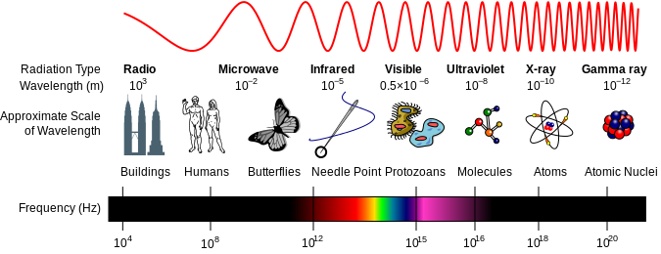
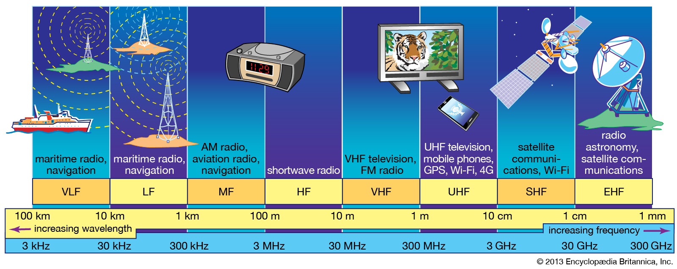
5G Emerging Tech: mmWave vs Sub6 … what’s going on?
Most home telecommunications today occur in this range.
Graphics: Inductiveload, NASA / Wikipedia; Britannica

Slide 35
Comparison of 2G~5G by frequency range
2G: GSM/GPRS/EDGE
3G: UMTS/FOMA
4G: WIMAX/LTE
5G mmWave
5G Sub6
Wi-Fi = 2.4 or 5 GHz
Graphics : Britannica. Frequency ranges are approximate.

Slide 36
mmWave vs Sub6
mmWave
Sub6
Higher frequency (30-300 GHz)
Harder to go through buildings (“line-of-sight”)
Less coverage
Requires specific phone models (as of 2021)
mmWave compatible hardware is expensive at the moment.
Lower frequency (Sub6 = “less than 6 GHz”)
Easier to go through buildings
Better coverage
More compatible models
Personal comments: Unless you live in a big city and confirmed that your carrier supports mmWave, you probably don’t need to pay for devices that support it for now.

Slide 37

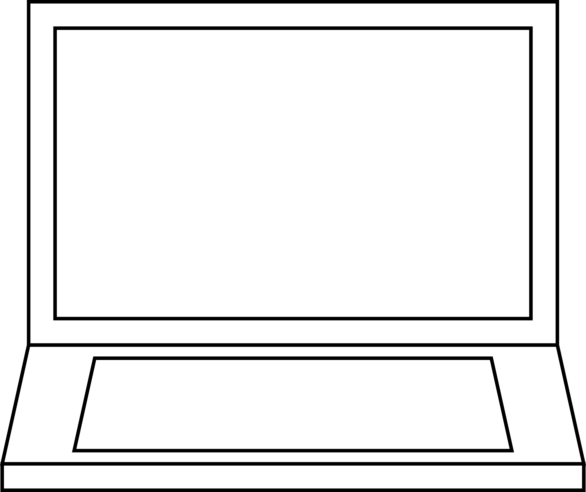
Data Link Layer
Application Layer
Transport Layer
Network Layer
Data Link Layer
Physical Layer
TCP/IP Protocol Model

Slide 38
Roles of the Data Link Layer
Lowest abstraction level possible
Collision detection
Error detection
Stop sending when others are sending
Packet Switching

Slide 39
More things in Data Link Layer
MAC Address
D8-12-E9-7B-2C-C0
D8-12-E9-7B-2C-C1
D8-12-E9-7B-2C-C2
D8-12-E9-7B-2C-C3
D8-12-E9-7B-2C-C4

Slide 40
Your device may have more than one MAC address.
2D-3B-8D-20-A4-AC
One MAC address is (supposed to be) globally unique.
00-18-C2-6C-40-8D

Slide 41
Network Layer: The Internet Protocol
158.108.8.7
Application Layer
Transport Layer
Network Layer
Data Link Layer
Physical Layer
TCP/IP Protocol Model
163.221.222.222

Slide 42
Key roles of the Internet Protocol
Internetwork Routing
IP Address as Globally Unique Address System
Provides a common format for packets
Pretty much all protocols in the world rely on IP.
There are no repeated IP addresses on the global scale.
Internetwork = Between the networks.
IP is the basis of the Internet itself.

Slide 43
How to check your MAC and IP addresses (Windows)
Ethernet adapter Ethernet 2:
Connection-specific DNS Suffix . :
Description . . . . . . . . . . . : Intel(R) Ethernet Connection (7) I219-V
Physical Address. . . . . . . . . : A8-A1-59-03-XX-XX
DHCP Enabled. . . . . . . . . . . : Yes
Autoconfiguration Enabled . . . . : Yes
Link-local IPv6 Address . . . . . : fe80::5886:7093:b8a2:7608%14(Preferred)
IPv4 Address. . . . . . . . . . . : 172.16.20.2(Preferred)
Subnet Mask . . . . . . . . . . . : 255.255.0.0
Lease Obtained. . . . . . . . . . : Sunday, October 24, 2021 18:36:39
Lease Expires . . . . . . . . . . : Tuesday, November 2, 2021 11:17:16
Default Gateway . . . . . . . . . : 172.16.0.1
DHCP Server . . . . . . . . . . . : 172.16.0.1
DHCPv6 IAID . . . . . . . . . . . : 195600729
DHCPv6 Client DUID. . . . . . . . : 00-01-00-01-28-03-18-C5-A8-A1-59-03-XX-XX
DNS Servers . . . . . . . . . . . : 172.16.0.1
8.8.8.8
8.8.4.4
NetBIOS over Tcpip. . . . . . . . : Enabled
Start command prompt
Type “ipconfig /all”
Do not share this information without technical need.

Slide 44
Difference between MAC and IP addresses
MAC Address
IP Address
Address for data link layer
Used for routing within network
Hardware-specific, cannot be changed (conventionally).
Address for network layer
Used for routing across networks
Can be configured by the OS.
Usually, one interface has one MAC address and one IP address.
In more advanced network configurations, this may change.

Slide 45
Transport Layer
Application Layer
UDP
User Datagram Protocol
(Connectionless)
Transport Layer
TCP
Transmission Control Protocol
(Connection-oriented)
Network Layer
Data Link Layer
Physical Layer
TCP/IP Protocol Model

Slide 46
This is where port numbers are!
Each computer can run multiple processes at a time.
Port numbers allow you to guide network traffic to each process.
:22 = ssh (remote control)
:68 = bootp/dhcp (network configuration)
:80 = web server
:8080 = another web server
IP Address: 10.0.0.8
If you want to connect to this computer using ssh,
you should access “10.0.0.8:22”.
Full list of all common port numbers: https://www.iana.org/assignments/service-names-port-numbers/service-names-port-numbers.xhtml

Slide 47
What TCP does that UDP doesn’t?
Connections
TCP has a sense of connections being open or closed, which allows TCP to implement the following features!
Congestion control
Adjust communication speed when the network is busy.
Packet ordering
TCP keeps track of packet order, so they arrive “in-order”.
Error Detection and Retransmission
TCP can detect errors and resend packets if they fail. The data recipient reports the errors back to the sender.

Slide 48
General uses of UDP and TCP
When to use UDP
When to use TCP
When small amounts of packet errors is OK.
When your application is small and does very simple quick things.
When you have more networking than device memory (using embedded/small hardware)
Applications include:
media streaming
telemetry (device data) streaming
real-time gaming (FPS, etc.)
When you need total correctness of the data.
When you need the security features of TCP.

Slide 49
Finally, we’re at the application layer!
Lots of functionality is provided here, and this layer has the greatest variety of protocols and applications.
Application Layer
Transport Layer
Network Layer
Data Link Layer
Physical Layer
TCP/IP Protocol Model

Slide 50
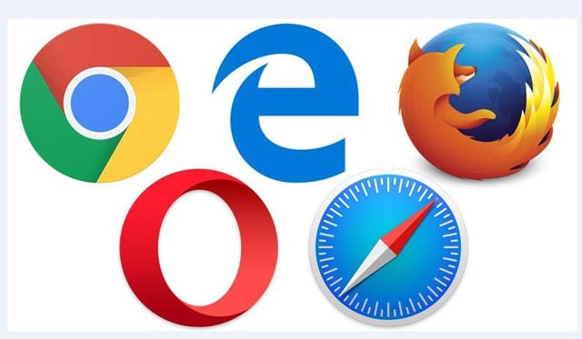


Examples of Application-Layer Protocols
>nslookup kanazawa-u.ac.jp
Server: UnKnown
Address: 172.16.0.1
Non-authoritative answer:
Name: kanazawa-u.ac.jp
Address: 133.28.0.180
Domain Name Services (DNS)
Hypertext Transfer Protocol (HTTP)
The main protocol for the World Wide Web
Message Queue Telemetry Transport (MQTT)
Very prominent in Internet of Things
Extensible Messaging and Presence Protocol (XMPP)
Some chat apps use this protocol.
Trademarks are owned by their respective owners.

Slide 51
Examples of Application-Layer Protocols
Can anyone give me an IP address?
Okay, I got 10.0.0.9 for you. Your default gateway and DNS are 10.0.0.1. Is this OK?
Great. Please do.
OK. All done!
Dynamic Host Configuration Protocol (DHCP)

Slide 52
And so on!
There are hundreds of application layer protocols. More are being developed every day.
You don’t have to remember the details. The most important thing today is to understand the context of things so it’s easier for you to learn in the future.

Slide 53
What can you learn further in single sentences?
Virtual Private Network (VPN)
Encapsulate and encrypt total data transmission to achieve privacy.
Internet of Things (IoT)
Many small devices communicate and provide useful functionality in physical world.
Personal Area Network (PAN)
Things around your body that communicate with each other.
Blockchain
Using concepts in computer networks, computation, and security to create a tamper-proof public record system.
We’ll talk about this later!

Slide 54
Class Announcement (again)
Report 1 is due next week.
レポート１の締め切りは来週です。
Submission closes 2021-11-09 11:59:59 JST.
Late submissions lose 20% points per day.

Slide 55




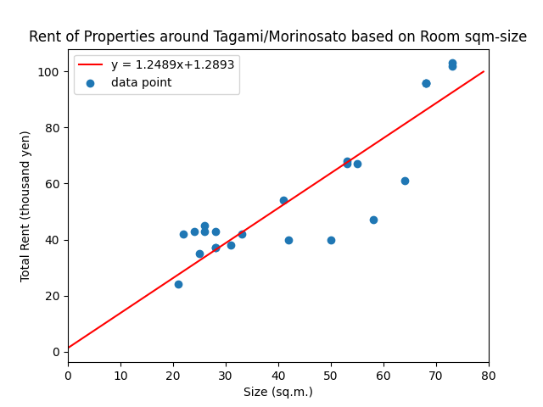


That’s all for today!
Graphics (characters): Lunatic Company, used with explicit permission.

Slide 56
Fair Use Indicator (If you want to copy my slides for personal use)
See slide number below.
If the number is gray, you are okay. All content (text, pictures, etc.) is mine.
If the number is blue, some content belongs to Kanazawa University. It might be okay for personal use.
If the number is red, some content belongs to non-KU entity. Copy with caution.
This includes Microsoft icons and clip-arts, but not shapes, fonts, and styles that come with PowerPoint itself.
If a slide contains both blue and red content, the number will be red.

